Slide 1
Operator Interface
Notes:
This slide should feature the main topic title as well as any slightly more specific subtitle that may help identify the topic when displayed to students.
For example:
Title: DVT ActiveX Controls
Subtile: How to build a DVT enabled ActiveX application.

Slide 2
Objectives
The student will correctly describe the operation of these Graphics functions:
  Button
  CheckBox
  ListBox
  EditString
  EditRegion
  Dialog
  Wizard
  StatusLight
The student will successfully create a Custom View in a job, including Status indicators, results of vision analysis, and a Button to activate calibration

Slide 3
Step 3: Design Operator Interface
Determine what operator controls may be needed for:
- set up
- production
Determine how results will be reported or communicated:
- Custom View
- discrete output lines
- serial output lines
- networking
1. Analyze Problem
2. Create Prototype Job
3. Design Op Interface
4. Complete & Deploy
Notes:
Now you need to determine how the user will interface with the vision system. It is recommended that you paper prototype your interface before you begin to design them.
Reasons why this is important:
1. To avoid overwhelming the operator with controls. Spread them out over several panels, group them logically.
2. You don’t want unnecessary controls showing on the screen when not needed.
3. Designing the operator interface for ease of operator use is key.
4. Both human to Checkpoint and machine to Checkpoint interfaces are important.

Slide 4
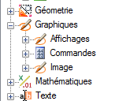
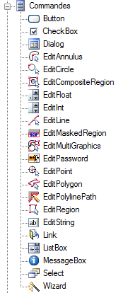
Graphics Functions: Controls
Controls
Functions for building an operator interface
1. Controls allow operator to enter or change information in spreadsheet, without having to use Formula Editor or Property Sheet

Slide 5
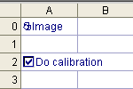

Controls: CheckBox
Returns 1 when box is checked, 0 when it is not
To check or uncheck box, click on cell containing CheckBox
1
0

Slide 6
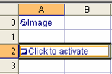
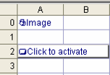
Controls: Button
Returns momentary 1 when Button is clicked, 0 otherwise
To activate Button, click on cell containing Button
1
0

Slide 7
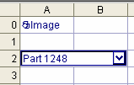

Controls: ListBox
Allows user to select item from a pull-down list
Index (0, 1, 2, …) is stored in the cell
0 1 2
Example: Use as index in Choose function to select different thresholds for different parts
Choose (cell, value for Index 0, value for Index 1, …)
Choose (A2, 1.34, 2.11, …) where A2 is cell with ListBox
Notes:
From: Tamotsu Tanabe
To: Tom Baker; Nick Bruder
- Each item should be able to be up to 255 characters, if they are referencing cells containing strings.
- The max number of items should be (MAX_SUBEXPR - 1). MAX_SUBEXPR was extended to 38 in Rel1.2(?),
but there might be a problem in parser so it might be 1 or 2 less than that.
- The length of the Listbox() function itself needs to be less than about two hundread or so.
-----Original Mesage-----
From: Tom Baker
I couldn't find the answer to this from looking through the source. I would guess that it is 32 items and 255 characters per item. Am I close?
Tom

Slide 8


Controls: EditFloat & EditString
EditFloat
EditString

Slide 9

EditRegion
Defines a Region which can be referenced by one or more Vision functions
Auto-inserted functions that describe region
Can be referenced by vision functions

Slide 10

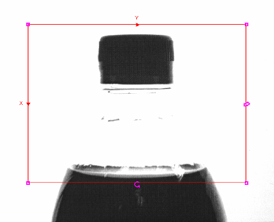
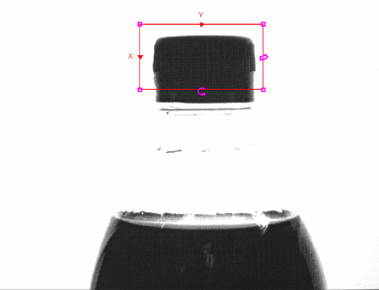

EditRegion

Slide 11


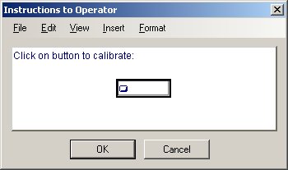
Dialog Boxes
Dialog Box is pop-up window that overlays spreadsheet
Consists of cells above normal spreadsheet (A400 & higher)

Slide 12
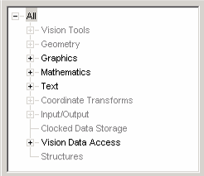
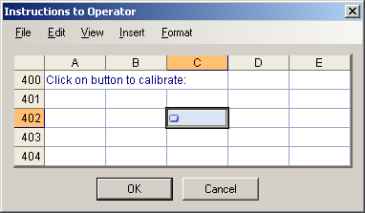
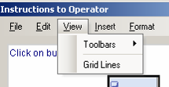
Dialog Boxes
Can insert many of same kinds of things as normal spreadsheet, but not vision functions
Can make references between Dialog Box and main spreadsheet
Can turn gridlines on or off:

Slide 13
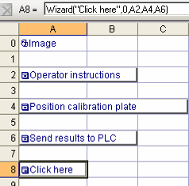
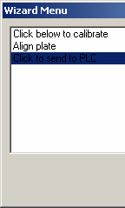

Wizards: Menu Mode
Wizard connects 2 or more dialog boxes
Mode is 0 for menu, 1 for sequential
Dialog boxes
Wizard

Slide 14
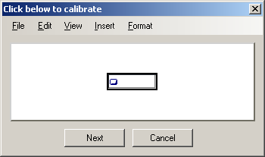
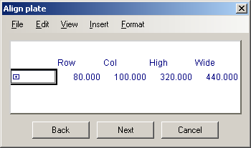
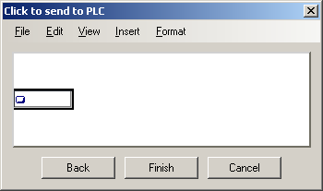
Wizards: Sequential Mode
Returns to spreadsheet
Dialog Boxes & Wizards provide easy-to-use Graphical User Interface (GUI)

Slide 15

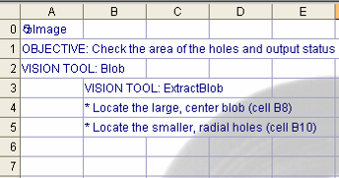

Link Function
Link is a Graphics function that behaves like a logon
Operator clicks on cell, is taken to another camera’s interface
Emulator
In-Sight 5400 (remote)

Slide 16
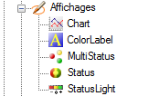
Graphics Functions: Displays
2. Displays put graphical information onto the spreadsheet

Slide 17
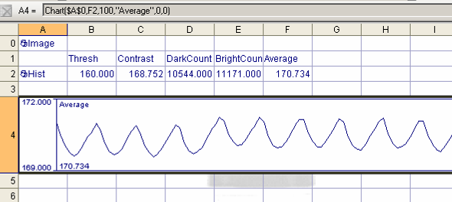
Displays: Chart
Chart plots a value over time.
Example: Histogram Average

Slide 18

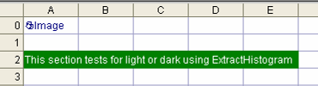
Displays: ColorLabel
Displays background and text in colors

Slide 19
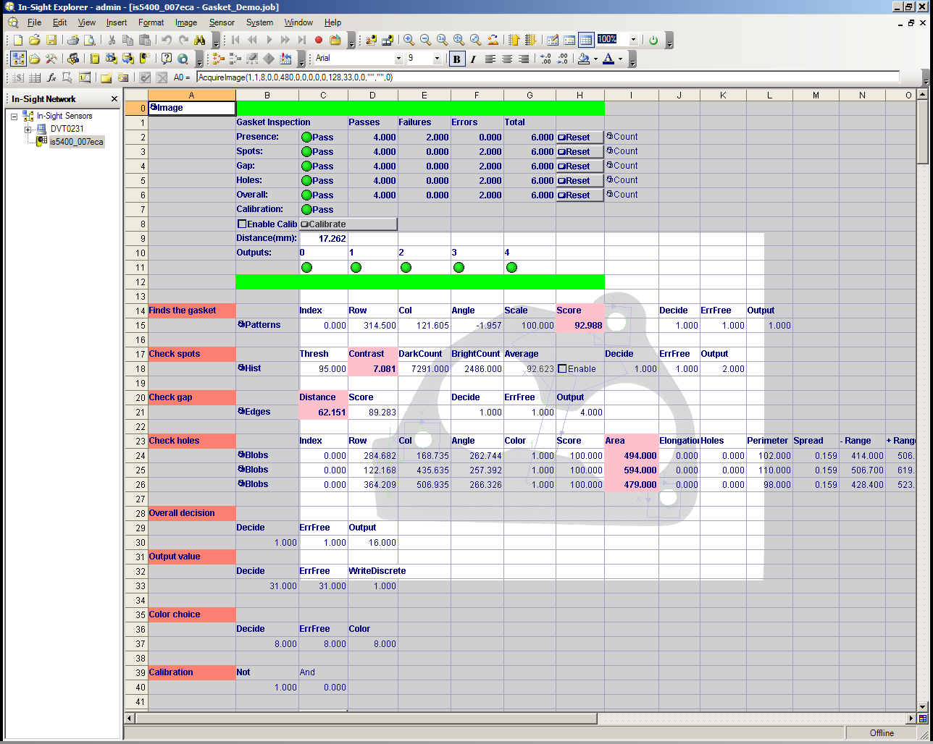

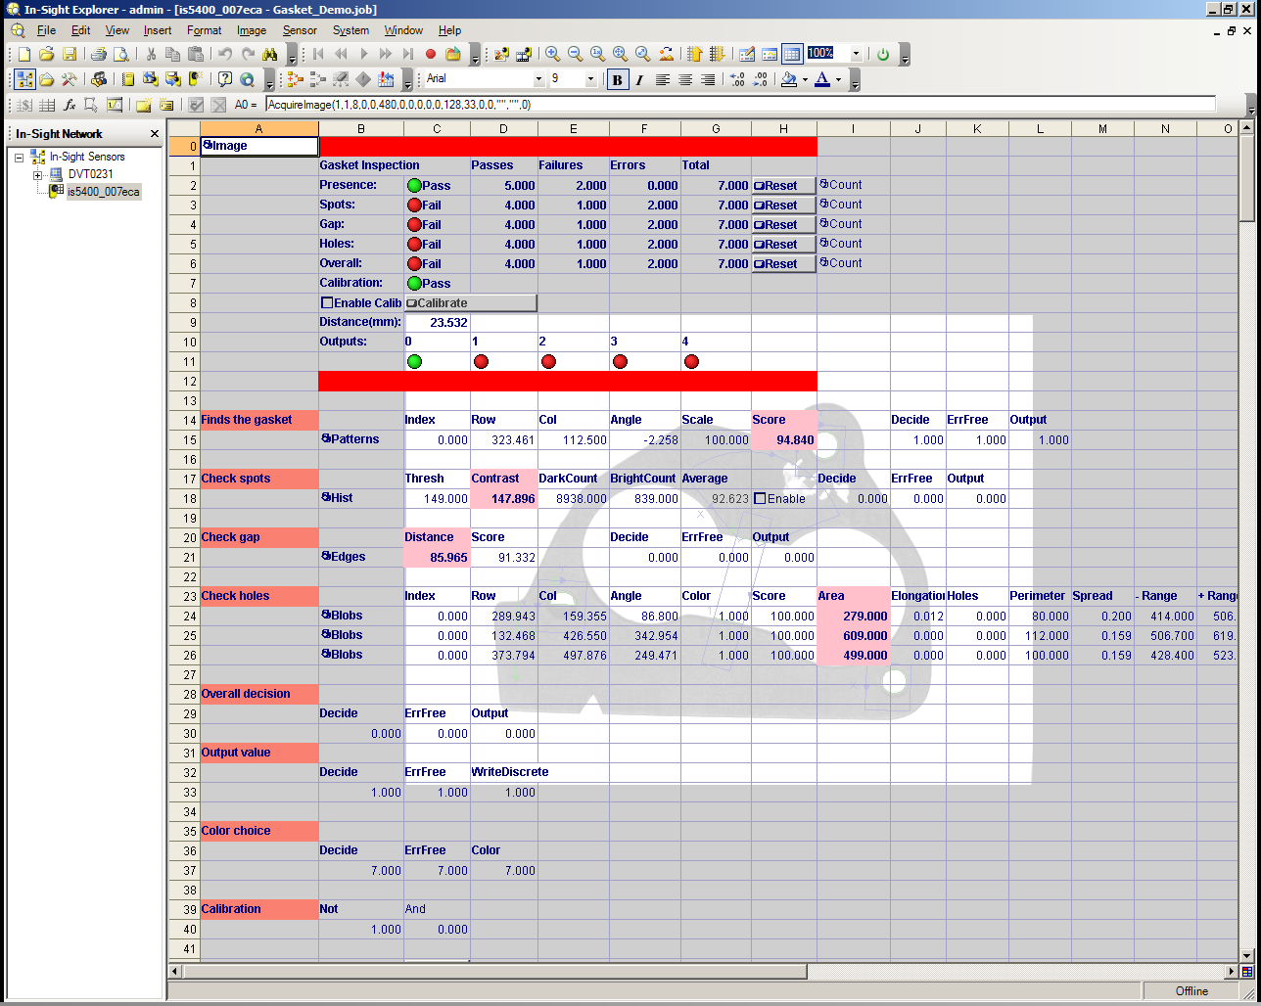
Using Comments: Color Labels
Color Labels can be made to change based on logic

Slide 20

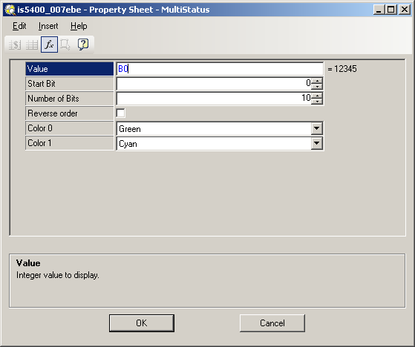
Displays: Status, StatusLight, MultiStatus
All three functions reference another cell
Status: negative→ zero→ positive→
StatusLight: You choose colors from list
MultiStatus: Two colors for each bit, you choose colors from list

Slide 21
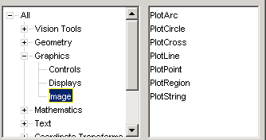
Graphics Functions: Image
3. Image functions allow you to draw information on the image itself

Slide 22
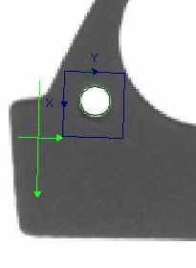
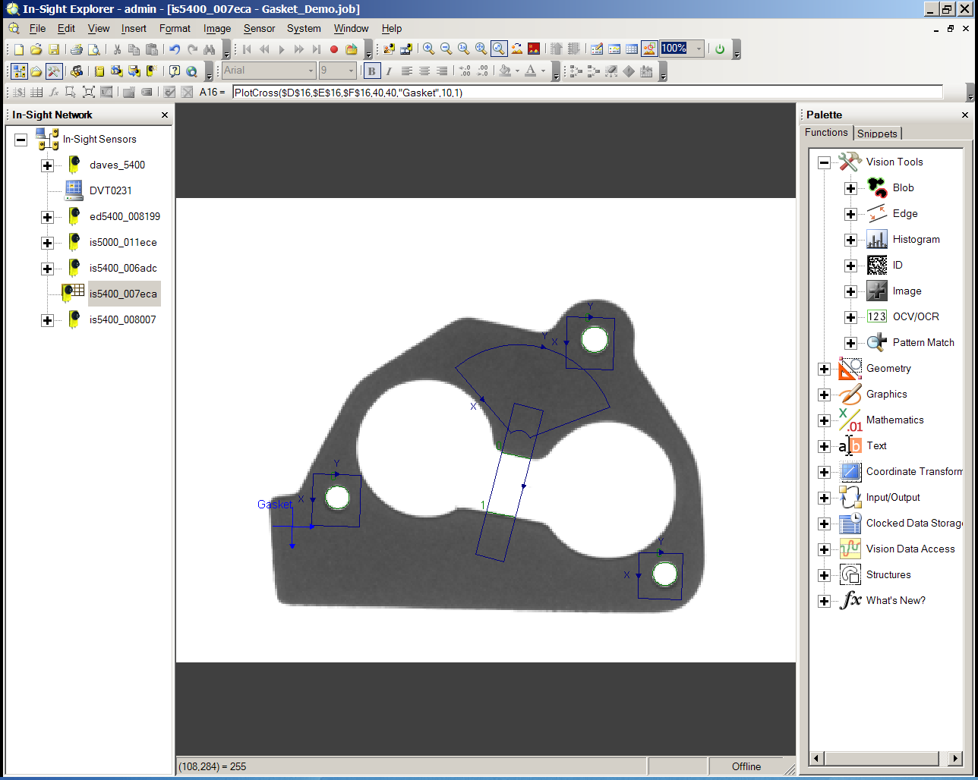
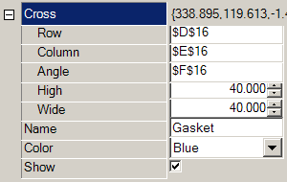

Image: PlotCross
You can replace standard tool graphics with custom graphics
Row, Column & Angle
reference tool result
locations

Slide 23
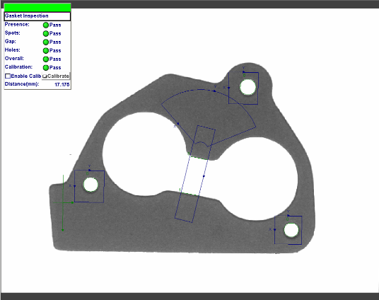
Custom View
A Custom View allows the user to select a portion of the spreadsheet that will be displayed at run-time

Slide 24
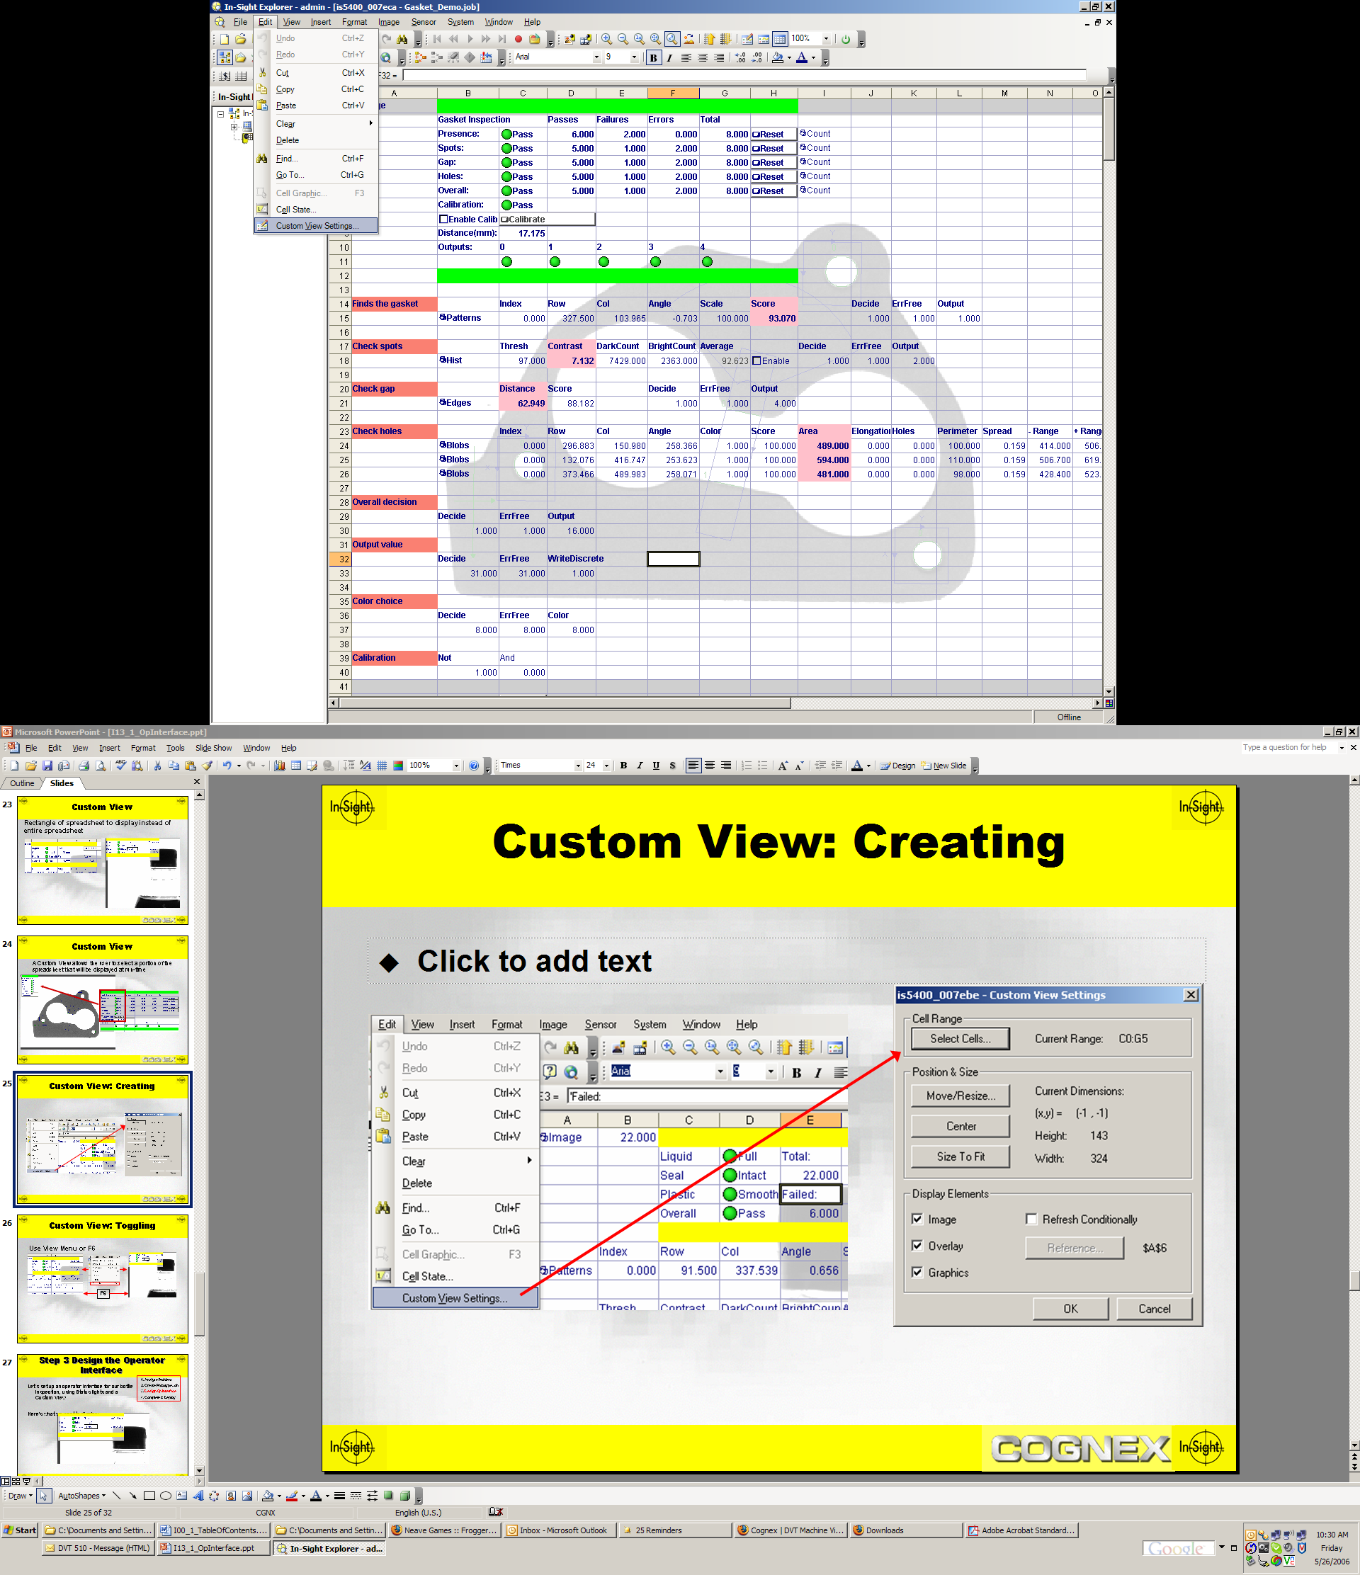
Creating a Custom View
To edit Custom View settings click here:

Slide 25
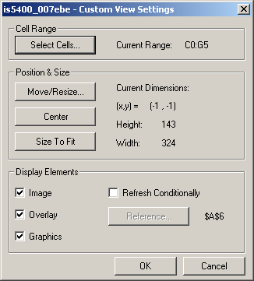
Custom View Settings
Allows selection of cells used for Custom View
Allows setting of size and location of Custom View
Centers Custom View on display screen
Resizes Custom View to original cell sizing
Enable/disable display of:
  Image
  Spreadsheet
  Graphics
Allows update of display to be controlled through logic

Slide 26
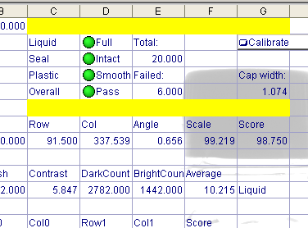
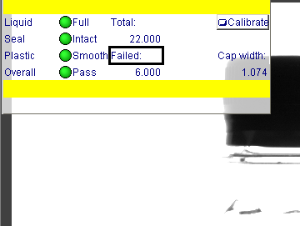
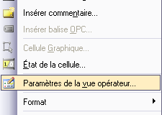
Choix de l’interface opérateur
Touche F6
Sélection d’une plage de cellules dans la vue de développement
Seules les cellules choisies apparaissent dans la “vue opérateur”
Notes:
Diapositive <number>
Notes :
_________________________________________________________________________________
_________________________________________________________________________________
_________________________________________________________________________________
_________________________________________________________________________________
_________________________________________________________________________________
_________________________________________________________________________________
_________________________________________________________________________________

Slide 27
Custom View References
For each of the tests, we used an If function to generate a 1 for pass, 0 for fail. These are the values you can use with StatusLight.

Slide 28
CountPassFail Function
The CountPassFail function accurately tracks the number of passing, failing, and erroneous results.
It tracks 1s as passing, 0s as failing, and #ERR or negative numbers as errors.
You can also choose to allow a manual resetting of the statistics.
Allows manual reset of statistics.

Slide 29
Summary
Graphics Functions consist of
Control functions, which allow the operator to enter or change information (buttons, checkboxes, etc.)
Display functions, which show graphical information on the spreadsheet (status lights, charts, etc.)
Image functions, which draw information on the image (crosses, points, etc.)

